Slide 1
PIGGY BANK
Team Echo
Caroline Cordes, Phoebe Miller, Chloe Burgess, Laasya Ravipati
Notes:
Phoebe

Slide 2

BACKGROUND
Customer interface aspect of an ATM
Piggy Bank:
Bank primarily for a younger demographic
People that are just starting to get into money management
Children/Teens
Business Rules
Every Customer has one Account
Every ATM can perform many transactions
Every Customer can perform many transactions
One bank is connected to multiple ATM's
Notes:
Phoebe
Customer interface, so we took the position of an ATM transaction
We kept it simple because our target demo is kids
For simplicity, customer can only have one acct
As usual an atm performs many transactions
Same for customers, one customer can perform many transactions
And one bank has many ATMs

Slide 3
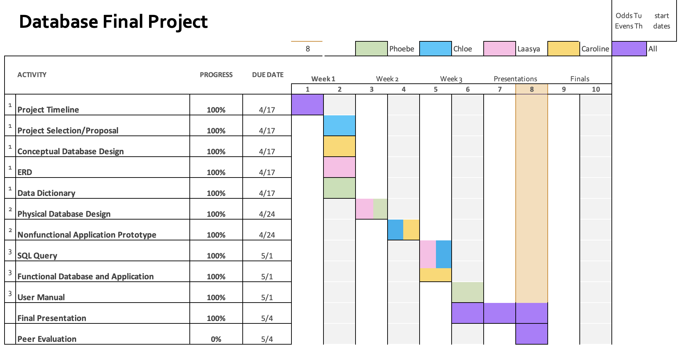
PLANNING
Notes:
Laasya

Slide 4
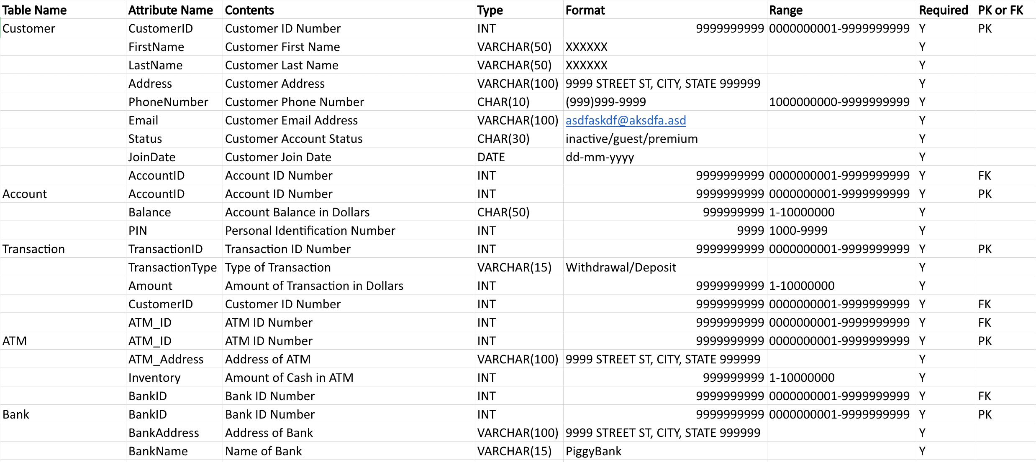
DATA DICTIONARY
Notes:
Phoebe
We have 5 entities, with mostly integer attributes (besides the customer table having a lot of varchar)
The data dictionary served as a reference for the ERD

Slide 5
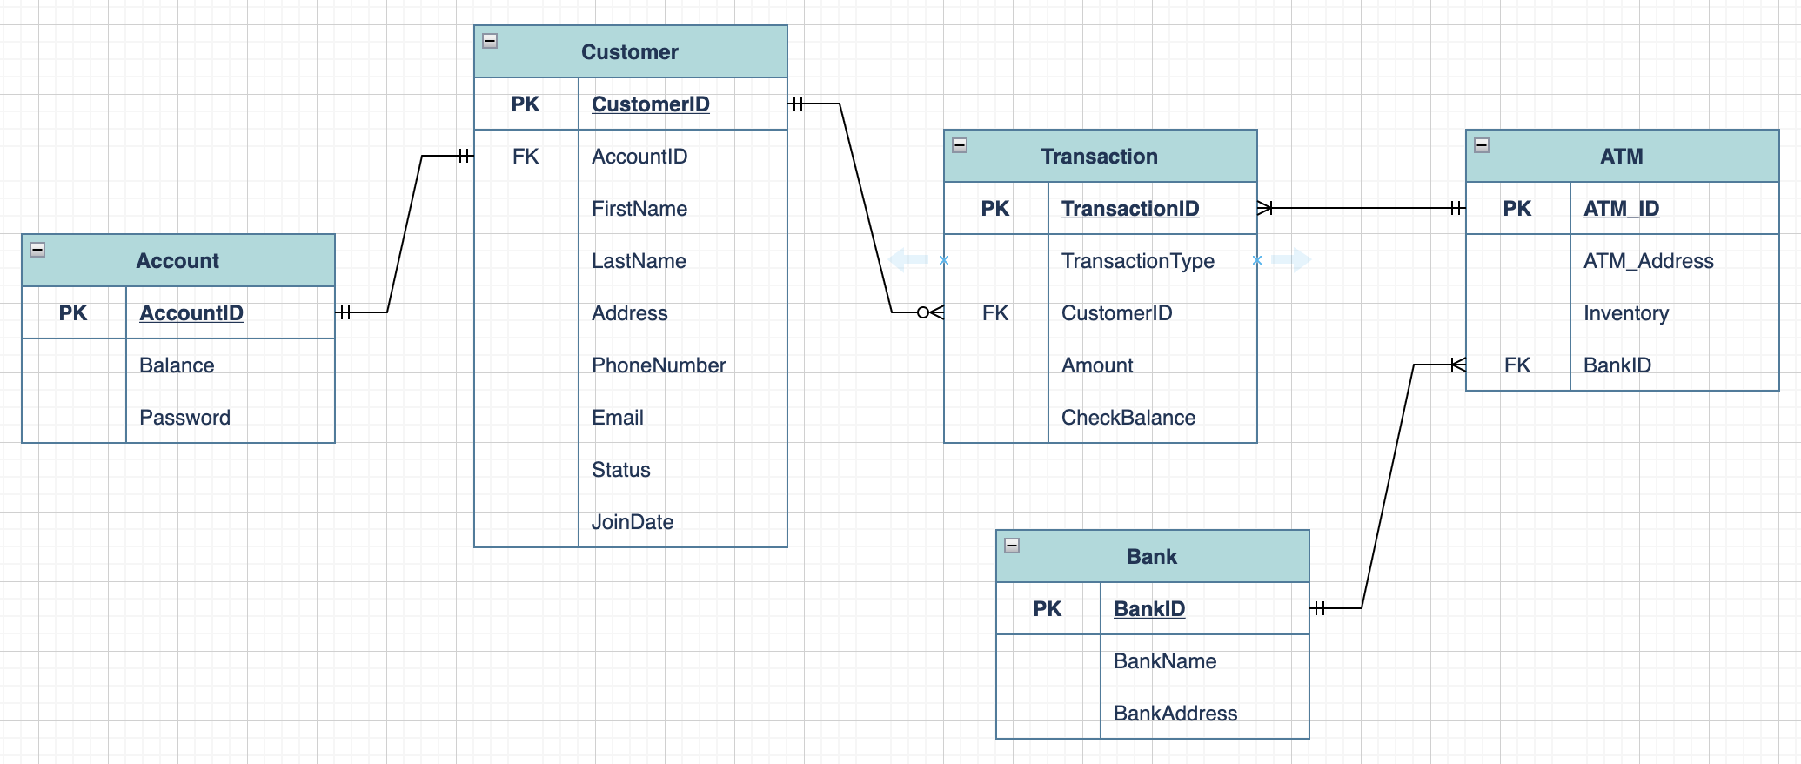
ENTITY RELATIONSHIP DIAGRAM
Notes:
Phoebe
Used to have a couple bridge entities, but realized we didn’t need them because no m2m relationships
Customer is ki

Slide 6

SQL Queries
Login:
SELECT AccountID FROM Account WHERE (AccountID = ‘” + txtCardNumber.Text + ‘”) AND (Pin = ‘” + txtPin.Text + ‘”)
Display Balance:
SELECT Balance FROM Account WHERE (AccountID = ‘” + AccountID + ”’)
Account Information:
SELECT Customer.FirstName FROM Customer INNER JOIN Account ON Customer.AccountID = Account.AccountID WHERE (Account.AccountID = ‘” + AccountID + ”’)
Same for the other displayed information
Deposit:
UPDATE Account SET Balance = Balance + (“ + txtDepositAmount.Text + “) WHERE (AccountID = ‘” + AccountID + ”’);
Withdraw:
UPDATE Account SET Balance = (Balance - 100) WHERE (AccountID = ‘” + AccountID + ”’);
100 changed for the amount associated with the button pressed
Notes:
Laasya

Slide 7
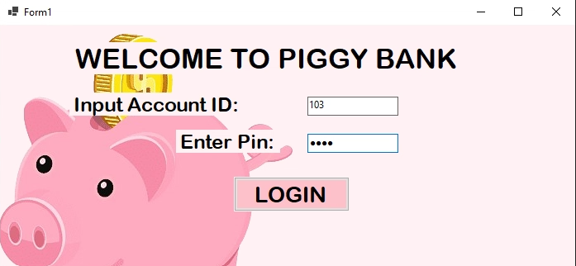
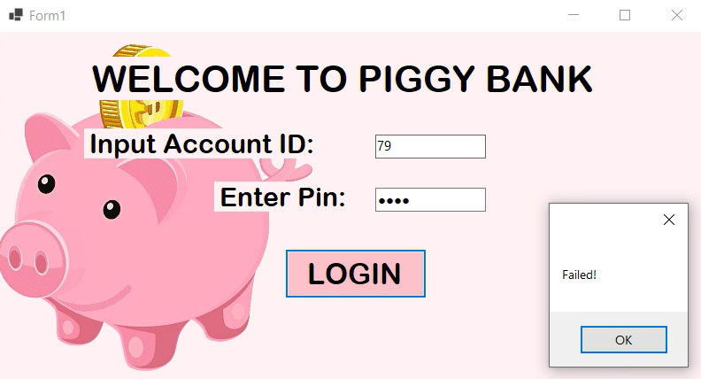
LOGIN SCREEN
This is where the user will enter their personal information to access their account
When the user enters their Pin, it will be hidden for privacy
They will then hit the LOGIN button it will either let them go to the options screen or will say 'Failed!'
Notes:
Chloe
No creating an account because that would be something you would do at the bank not at the atm

Slide 8

ACCOUNT MANAGEMENT OPTIONS
01
02
03
DEPOSIT
WITHDRAW
OVERVIEW
The user can choose a custom amount to deposit at our ATM into their account
The user can withdraw $10, $25, $50, or $100 from their account
This will show the user their information including current balance. From here they can go to the main menu and choose a different option
Notes:
Chloe

Slide 9
DEMO!
Notes:
Caroline
Do one go through where the login doesn’t work, then log in correctly
Explain the functionality of each screen
User can login into their account with their password hidden
They will then be able to see their account balance and choose what they want to do
Show the account screen
Do a deposit, withdraw, and then log out
Call on a person from the class and show their account (Chloe will have the data base pulled up)

Slide 10
Key Takeaways
Trial and Error
Simplicity is Key
Intricacies of C#
Notes:
Chloe Laasya
Intricacies of C# (we learned a lot about c#)
Global variable Account id
Knowing what element to use (datagridview vs texbox)
Knowing how to show data

Slide 11
Thank Y u!

Slide 12
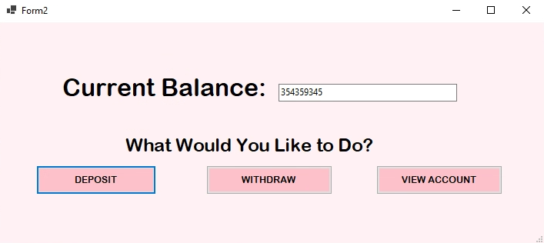
OPTIONS SCREEN

Slide 13

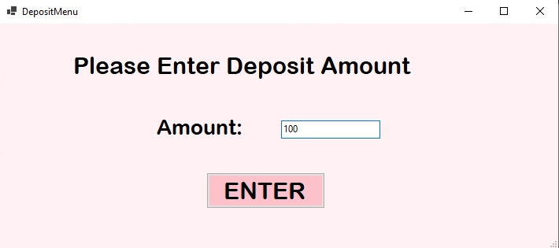
01.
DEPOSIT
Notes:
Caroline

Slide 14
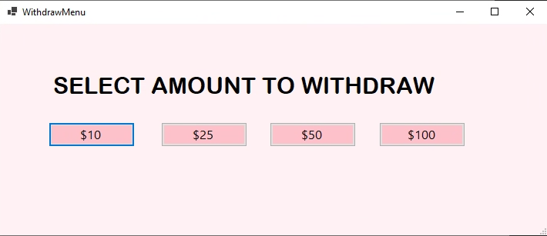
02.
WITHDRAW
Notes:
Caroline

Slide 15
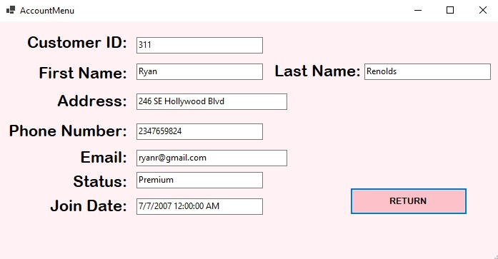
03.
VIEW ACCOUNT
Notes:
Laasya

Slide 16
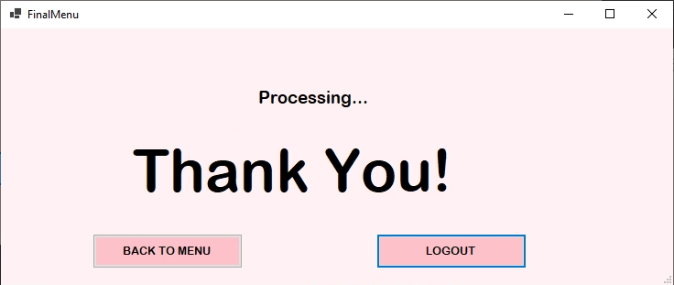
FINAL
04.

